Slide 1


Formula 1 Lap Time Prediction
Optimization Project
Optimization
2024/2025
PRESENTER
Daniele Gotti - 1079011
LOCATION
Dalmine, BG

Slide 2
Contents
What is Formula 1?
Project Goals
Data Preparation
Model Creation
Optimization
Conclusion
This project was developed in a Jupyter Notebook (.ipynb) using VS Code and Python within an Anaconda virtual environment.
The full project is available on GitHub: link.

Slide 3
What is Formula 1?

Slide 4
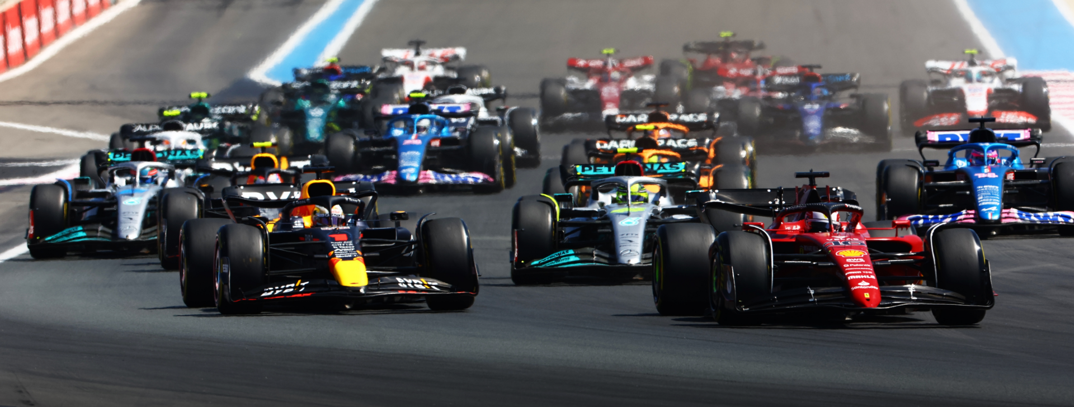
What is Formula 1?
Formula 1 (F1) is the highest class of international motorsport.
It features open-wheel, single-seater race cars competing in a series of Grand Prix events worldwide.
Each Grand Prix (24 GPs in 2025) is held on a permanent or street circuit in different countries and the race weekend usually spans three days.
Source: sportingnews.com

Slide 5
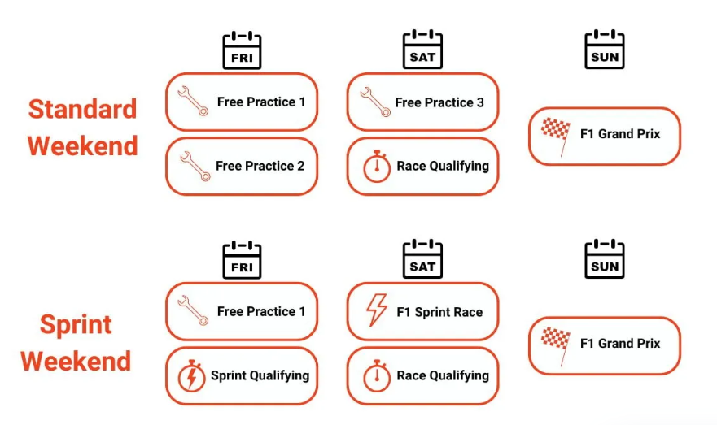
Race weekend
Source: fanamp.com

Slide 6
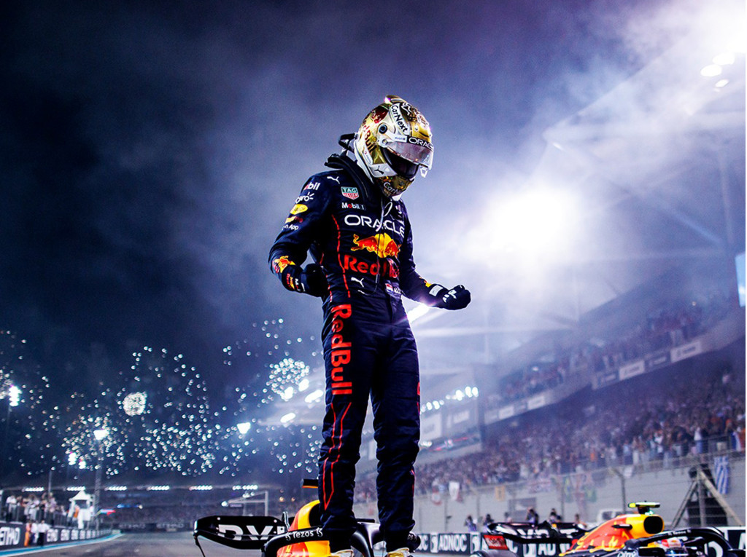
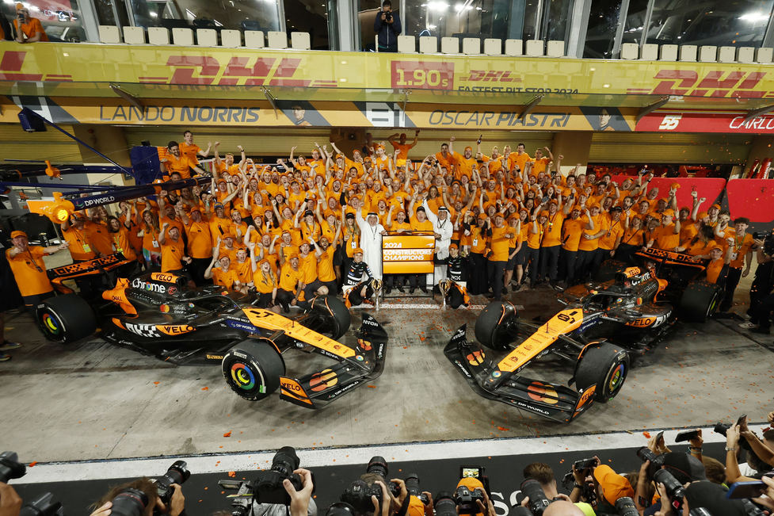
Teams, drivers and championships
Each team (constructor) fields two cars and employs two drivers.
Points are awarded based on finishing position. The driver and team with the most points at season’s end are crowned champions.
Teams compete in the Constructors’ Championship, and drivers in the Drivers’ Championship.
Source: sportingnews.com
Source: motorauthority.com

Slide 7

Cars
F1 cars are technological masterpieces, with hybrid power units combining a turbocharged V6 engine and energy recovery systems.
Made with carbon fiber, they're extremely light and fast: over 350 km/h top speed and 0 - 100 km/h in ~2.5 seconds.
Each car is designed and built by the teams within strict FIA regulations.
Source: motorionline.com

Slide 8
Why is Formula 1 fascinating?
Involves the best of engineering: aerodynamics, materials science, thermal management, mechanical design, information and electronic systems, etc.
Drivers undergo intense physical and mental training, enduring G-forces, high temperatures, and long concentration spans.
Anything can happen during a race, which is why strategy plays a crucial role (pit stops, accidents, etc.).
It’s a sport where even hundredths of a second can make the difference.

Slide 9
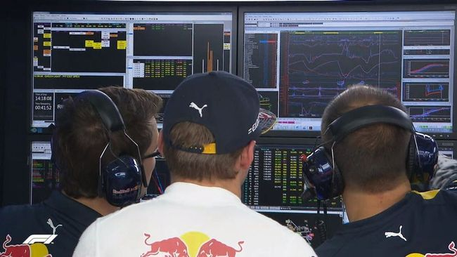
Why data is crucial in F1?
Each car has over 300 sensors collecting real-time data generating 1.1 million telemetry data points per second.
Data is used to:
- optimize car setup for each track.
- monitor performance and reliability.
- run simulations to test strategies .
- train drivers using advanced simulators.
Data informs race strategies: data scientists make fast decisions during the race.
Machine learning and AI are increasingly used to model race outcomes and competitor behavior.
Source: formule1fr.com

Slide 10
Project Goals

Slide 11
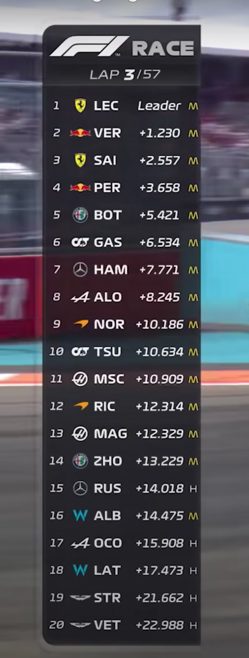
Project goals
Develop linear regression models to predict lap times based on multiple variables
Implement optimization techniques derived from gradient descent methods to minimize prediction error
Analyze model performance and interpret the influence of different factors on lap times
Source: f1friend.com

Slide 12
Why predict lap times?
Driver benchmarking: provide realistic targets based on car and track conditions.
Simulator Training: set lap time goals for driver development.
AI Calibration (Games): tune AI lap times to match real-world scenarios.
Car Development: evaluate design changes through simulated performance.
Race Strategy: support tire and fuel decisions with predicted pace.
Fan Engagement: Enhance broadcasts with expected lap time insights.

Slide 13
Data Preparation

Slide 14

Custom Dataset Construction
Pre-existing datasets on Kaggle or UCI were not suitable for my specific goal of predicting lap times under varying real-world conditions.
Instead, I created a custom dataset using the approach from a Kaggle notebook (Data Exploration with OCI), which leverages the FastF1 API (a F1 data service) to collect telemetry and race data.
The resulting dataset includes detailed lap-by-lap information from the 2023 and 2024 Formula 1 seasons.
References:
Kaggle notebook Data Exploration with OCI: link.
Code for dataset creation with FastF1 API: link.
FastF1 API documentation: link.
Source: docs.fastf1.dev

Slide 15
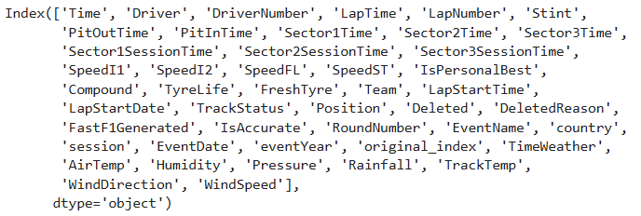
Original dataset
The result obtained using the API is a dataset (dataset_original.csv) containing 46 columns and 121534 rows. At first glance, many of these columns appear to be irrelevant.
The code for the following operations is contained in the file 1_Dataset_Preparation.ipynb.

Slide 16
Editing rows (1/2)
Removed rows where IsAccurate is false, as they do not meet the quality criteria for valid lap data (inlap or outlap, flags, safetycar, etc.).
Removed rows in which all of the following fields were null: Stint, Compound, and TyreLife.
Excluded drivers with minimal or unofficial participation.
Removed laps recorded under yellow flag conditions (i.e., where TrackStatus ≠ 1).
Excluded free practice sessions (FP1, FP2, FP3).

Slide 17
Editing rows (2/2)
Removed warm-up laps in qualifying sessions, retaining only laps within 5 seconds of the driver's best time in the same session.
Standardized team names (Alfa Romeo → Kick Sauber, AlphaTauri → RB).
Removed unofficial tyre compounds like test compound.
Converted LapTime to seconds.

Slide 18
Editing columns
Dropped unnecessary columns at the beginning: DriverNumber, Sector1Time, Sector2Time, Sector3Time, Sector1SessionTime, Sector2SessionTime, Sector3SessionTime, SpeedI1, SpeedI2, SpeedFL, SpeedST, IsPersonalBest, LapStartTime, LapStartDate, Position, DeletedReason, FastF1Generated, Country.
Added a new column FuelLevel based on estimated fuel consumption per lap.
Dropped additional columns after filtering and row operations: IsAccurate, PitOutTime, PitInTime, TrackStatus, Deleted, EventDate, Time, Stint, RoundNumber, TimeWeather, original_index.

Slide 19
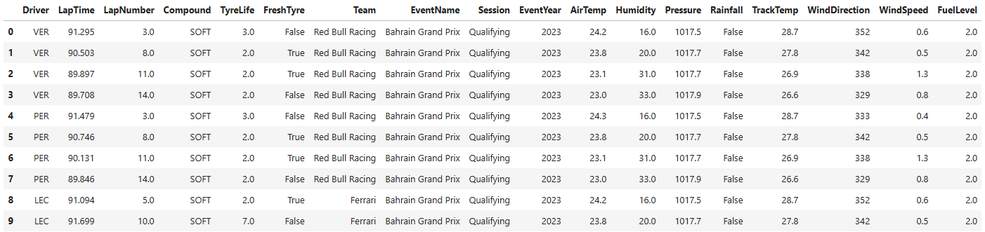
Final dataset
The new data have been exported to the file dataset_final.csv.
Changes include:
columns: 46 → 18;
rows: 121534 → 52160.

Slide 20
Model Creation

Slide 21
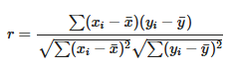
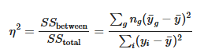
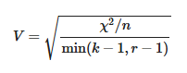
Analysis of correlations between variables
Numerical vs numerical variable: Pearson correlation coefficient (from -1 to 1)
Categorical vs numerical variable: Eta squared (from 0 to 1)
g = group,
n = number of observation in g.
Categorical vs Categorical variable: Cramér V (from 0 to 1)
X² = Chi-squared statistic;
n = number of observation;
k = categories of one variable;
r = categories of the other variable.

Slide 22
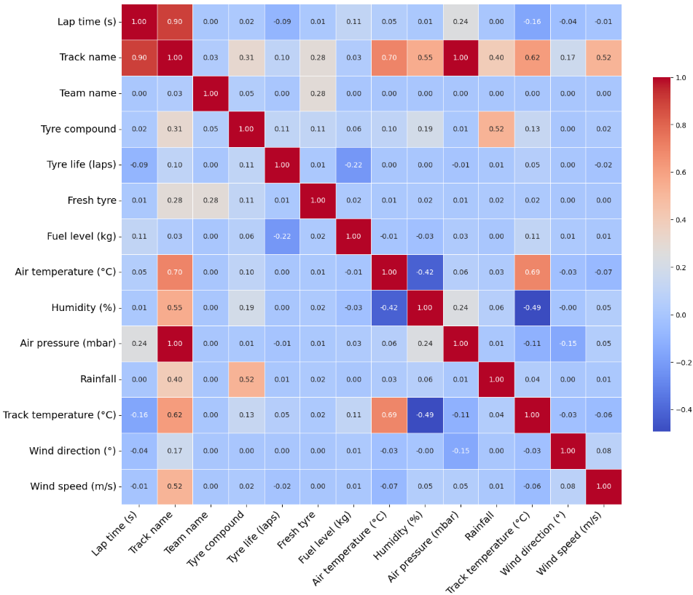
Correlation matrix
Lap times are highly correlated with the circuit.
Air pressure is excessively correlated with the circuit, while variables such as Air temperature and Humidity convey overlapping information.
Therefore, Air pressure, Air temperature, and Humidity will not be included in the model.

Slide 23
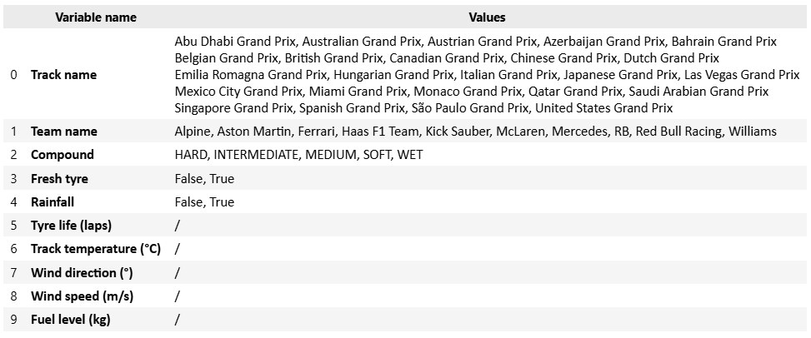
Model features
y = Lap time (s)

Slide 24
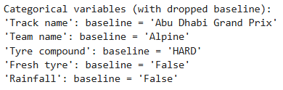
Model creation
Variables are standardized to have mean 0 and standard deviation 1.
The dataset is split 50% into training and testing sets (kept fixed throughout the optimization process to compare the results of different optimization methods).
Categorical variables are converted into dummies using one-hot encoding, with the first category of each variable set as the baseline.

Slide 25
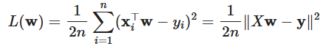
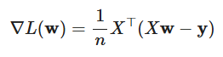
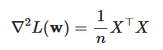
Linear regression
Loss function (objective): MSE (Mean Squared Error)
Gradient
Hessian

Slide 26
Optimization

Slide 27
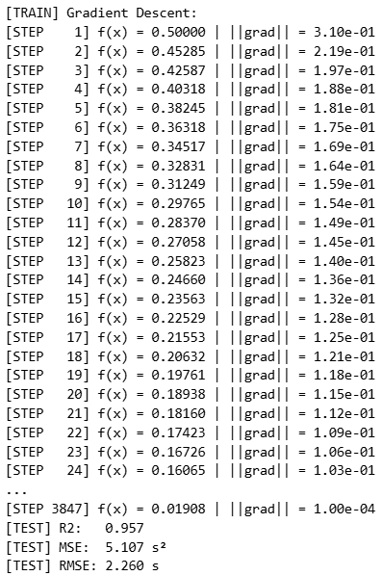
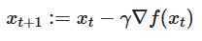
Gradient Descent (basic)
Assumptions:
tol = 1e-04;
x0 = zero vector;
max_iter = 10000;
gamma = 0.6.

Slide 28
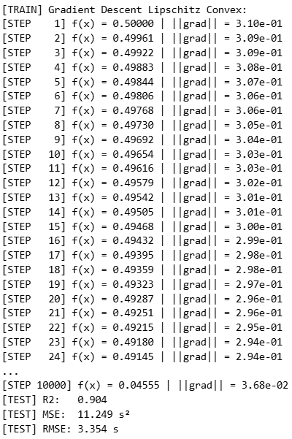
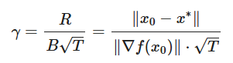
Gradient Descent (Lipschitz convex)
Assumptions:
tol = 1e-04;
x0 = zero vector;
max_iter = 10000;
x* = 0.01908 (GD result).

Slide 29
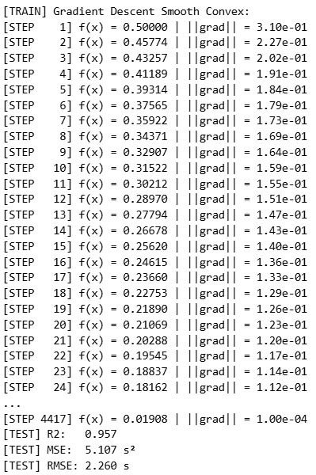
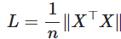
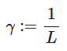
Gradient Descent (smooth convex)
Assumptions:
tol = 1e-04;
x0 = zero vector;
max_iter = 10000.

Slide 30
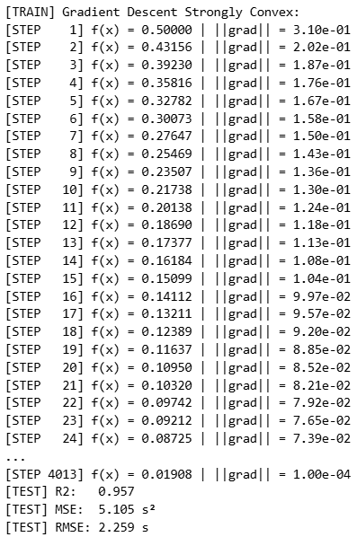
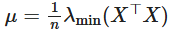
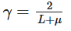
Gradient Descent (strongly convex)
Assumptions:
tol = 1e-04;
x0 = zero vector;
max_iter = 10000.

Slide 31
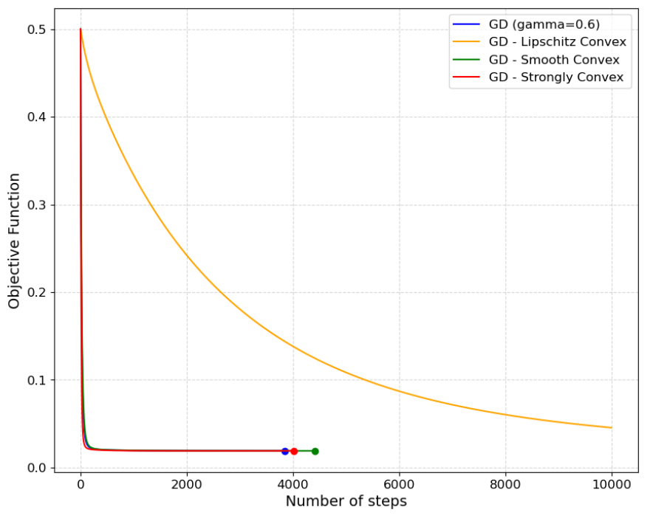
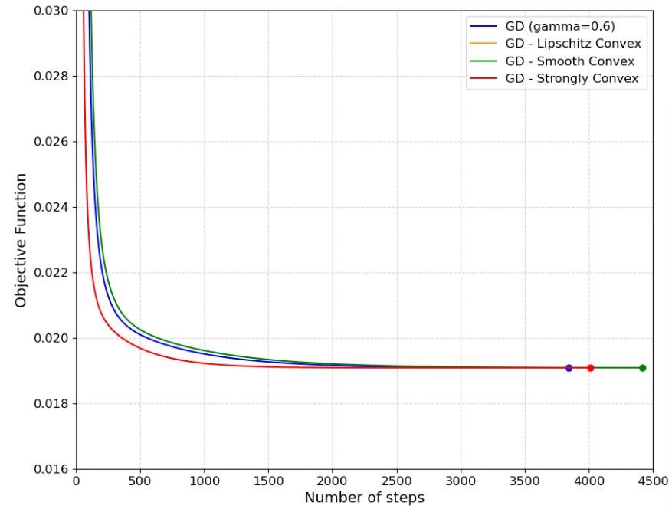
Comparison of GD methods

Slide 32
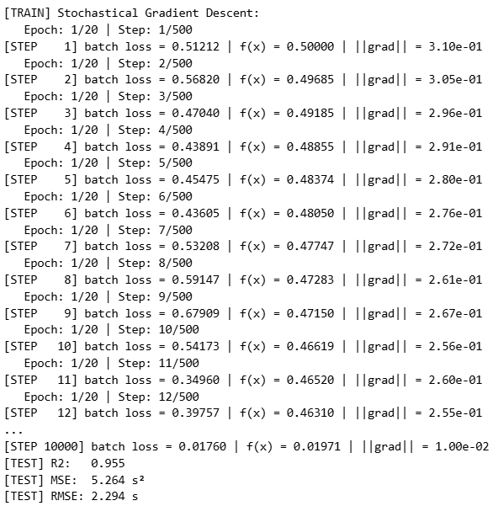
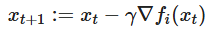
Stochastical Gradient Descent (basic)
Each epoch consists of several gradient updates.
The number of updates per epoch is as
max_iter / epochs.
In each step, a mini-batch of size batch_size is selected uniformly at random without replacement.
Assumptions:
tol = 1e-04;
x0 = zero vector;
max_iter = 10000;
gamma = 0.05;
batch_size = 32;
epochs = 20.

Slide 33
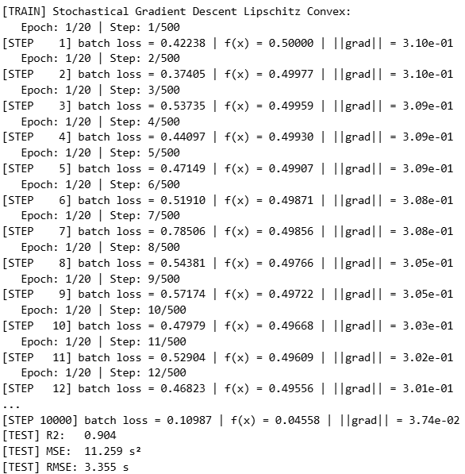
Stochastical Gradient Descent (Lipschitz convex)
Assumptions:
tol = 1e-04;
x0 = zero vector;
max_iter = 10000;
batch_size = 32;
epochs = 20.

Slide 34
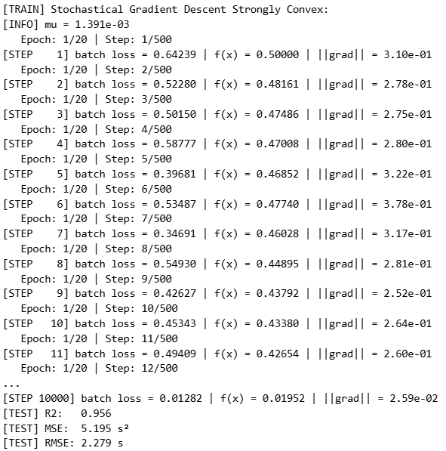
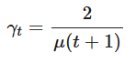
Stochastical Gradient Descent (strongly convex)
Assumptions:
tol = 1e-04;
x0 = zero vector;
max_iter = 10000;
batch_size = 32;
epochs = 20;
t0 = 10000.

Slide 35
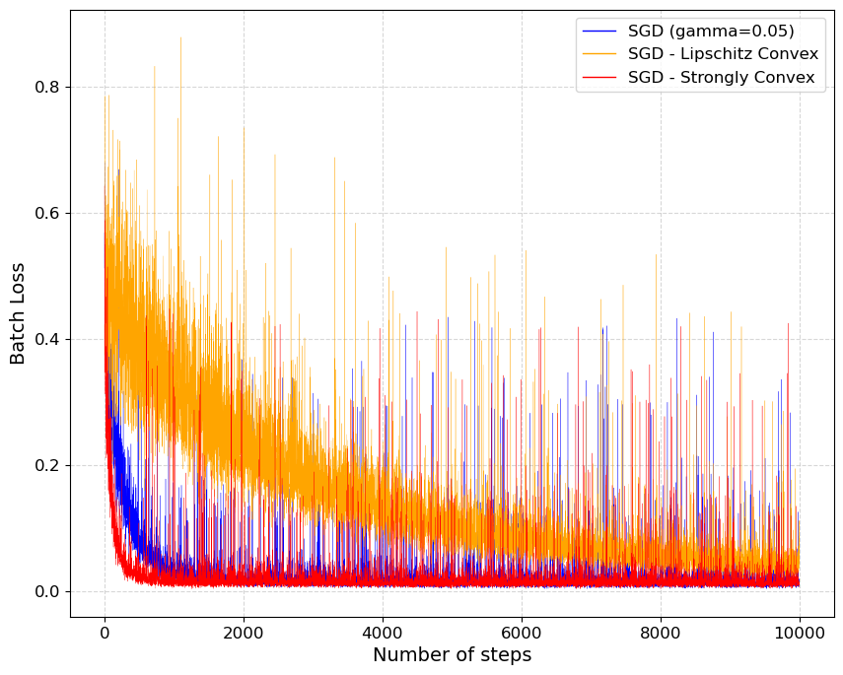
Comparison of Stochastical GD methods

Slide 36
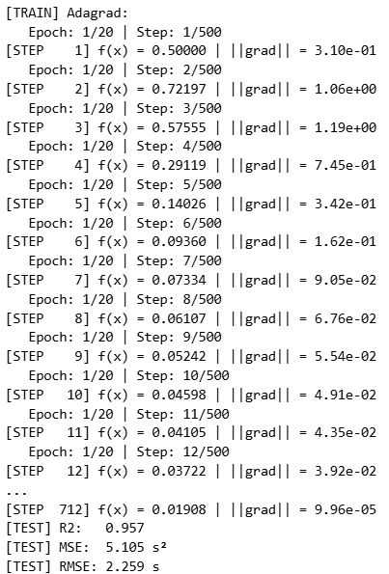
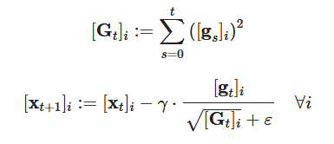
Adagrad
Assumptions:
tol = 1e-04;
x0 = zero vector;
max_iter = 10000;
gamma = 0.1;
epochs = 20;
epsilon = 1e-08.

Slide 37
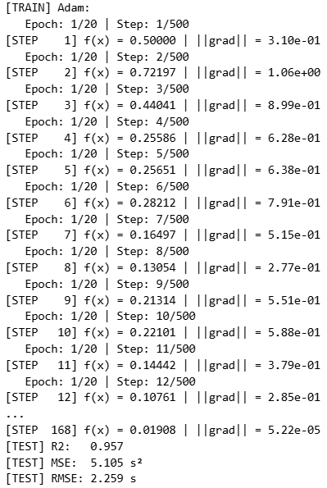
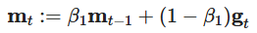
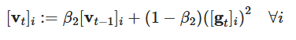
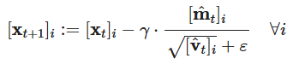
Adam
Assumptions:
tol = 1e-04;
x0 = zero vector;
max_iter = 10000;
gamma = 0.4;
epochs = 20;
epsilon = 1e-08;
beta1 = 0.9;
beta2 = 0.999.

Slide 38
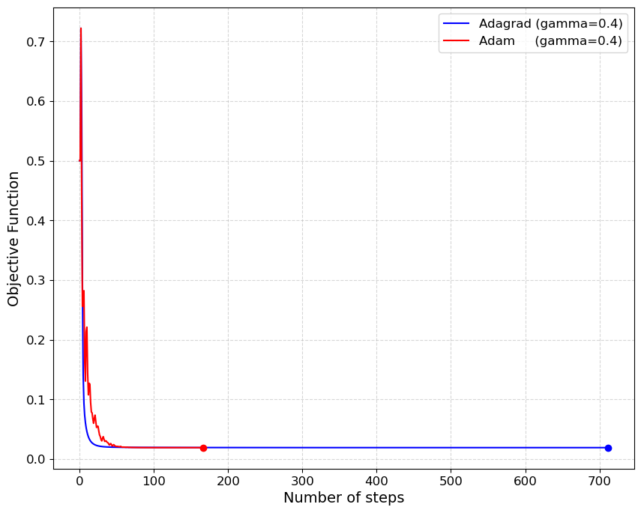
Comparison of Adagrad and Adam

Slide 39
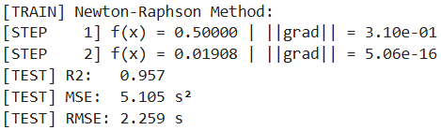
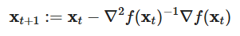
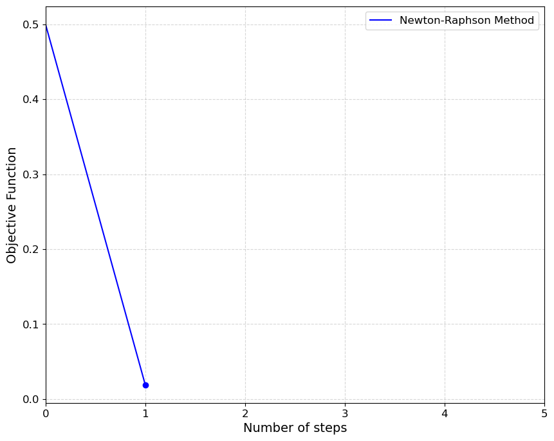
Newton-Raphson Method
Key property: because uses a quadratic approximation of the function, it converges in just one step if the function is exactly quadratic.
Assumptions:
tol = 1.00e-04;
x0 = zero vector;
max_iter = 10 000.

Slide 40
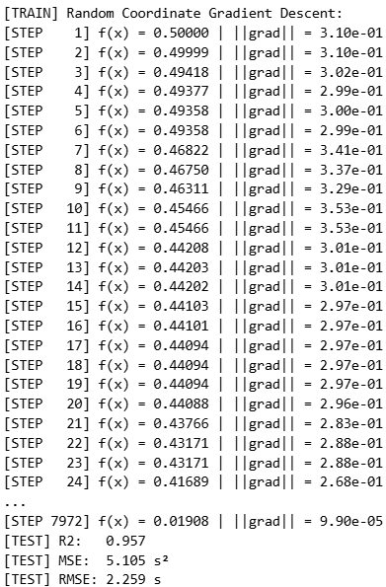
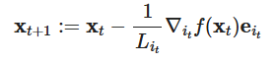
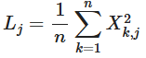
Random Coordinate Gradient Descent
Assumptions:
tol = 1e-04;
x0 = zero vector;
max_iter = 10000.

Slide 41
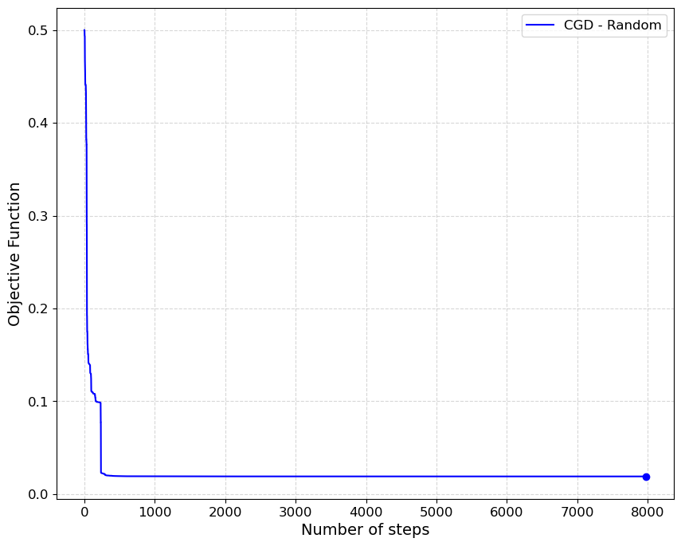
Random Coordinate GD

Slide 42
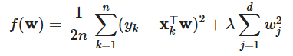

Proximal Gradient Descent for Lasso
Lasso regression: tends to zero out many coefficients, making the model more interpretable. The last term of the Lasso objective function is not differentiable; therefore, this problem is well-suited for Proximal Gradient Descent, as the first part is differentiable while the second is not.
At each step of Proximal Gradient Descent, we apply the following proximal operator, the soft-thresholding function.

Slide 43


Proximal Gradient Descent
Assumptions:
tol = 1e-04;
x0 = zero vector;
max_iter = 10000;
gamma = 1;
The code takes as input a range of lambda values, defined by lambda_min, lambda_max, and lambdas, and performs Proximal GD for each of them. In the end, it returns the solution corresponding to the lambda that yields the best results.
lambda_min = 0.005;
lambda_max = 1;
lambdas = 20.

Slide 44



Slide 45

Coefficient importance in Lasso
Feature importance is computed using the RMS (Root Mean Square) of the coefficients of the dummy variables if the feature is categorical, and using the absolute value of the coefficient if the feature is numerical.
The variables Wind speed, Fresh tyre, and Wind direction are not particularly relevant. We can remove them to simplify the model.

Slide 46
Conclusion

Slide 47
Conclusion
The most effective method for training the model is the Newton-Raphson method, as it converges in a single step and reaches a more precise minimum.
The overall results are promising, especially considering that the model does not account for factors such as driver skill, strategy, etc. which can significantly influence performance in this context.
The final model is implemented in the file 3_Final_Model, and is ready for use by the user. Here, the model is implemented using the entire dataset for training, in order to achieve greater robustness.

Slide 48



Slide 49
References
Lecture notes and slides provided during the Optimization course, academic year 2024 - 2025.
Kaggle notebook Data Exploration with OCI: link.
Code for dataset creation with FastF1 API: link.
FastF1 API documentation: link.

